Slide 1
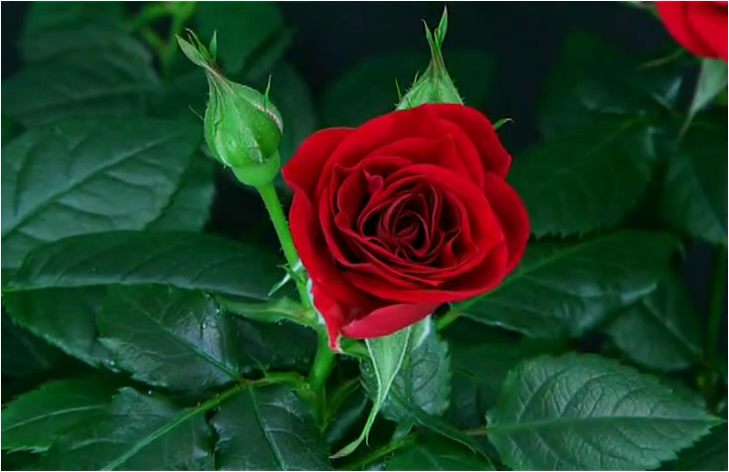
WELL COME

Slide 2
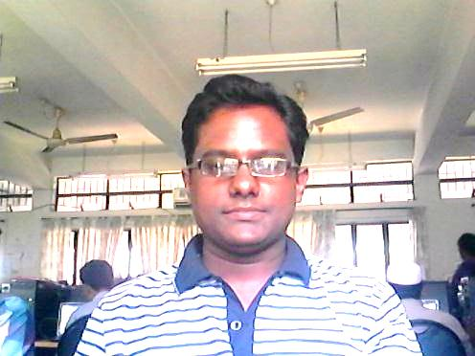
PRESENTER
Habibur rahman
Asst. teacher
Nasrin High School.
Bapta, Bhola.
Mobile: 01770616004
E- mail: nhabiburrahman @yahoo, com

Slide 3
Presentation
Teaching subject: English 1stpaper
Content: Pahela Boishakh
Unit : 3, Lesson :6
Class : 9
Class duration: 50 minutes
Date :14-04-2013

Slide 4
LEARNING OUTCOMES
By the end of this lesson they will be able to
Talk about a traditional festible.
Answer questions .
Give opinions in a logical sequence.

Slide 5
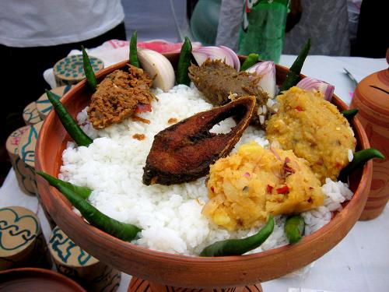
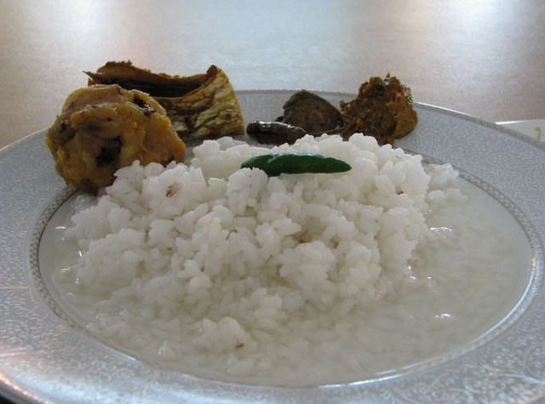
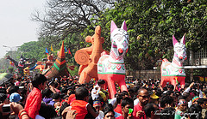
PAHELA BOISHAKH

Slide 6
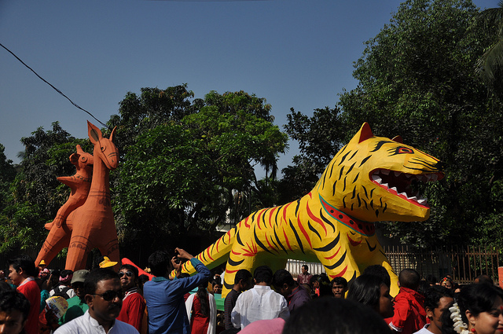
Single work
1.What is the picture about?
2.Where do you think it is?
3.What are the people doing?
Watch the picture answer the questions.

Slide 7
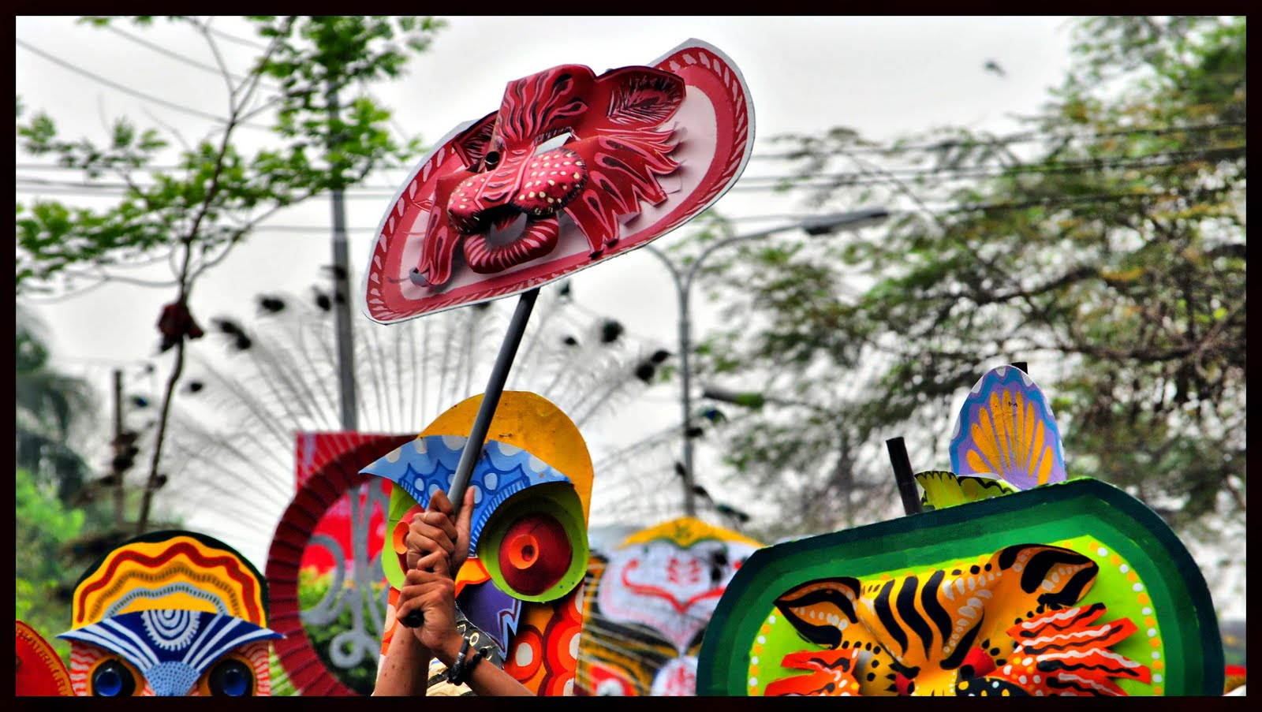
PAIR WORK
Watch the image & answer the following questions in pairs.
.
1.Do you go out in the morning of Pahela Boishakhi? If you do ,where do you go? If not what you do?
2.What kind of food you eat in the morning of Pahela Boishakhi?
3.Do you wear any special clothes on this occasion?

Slide 8
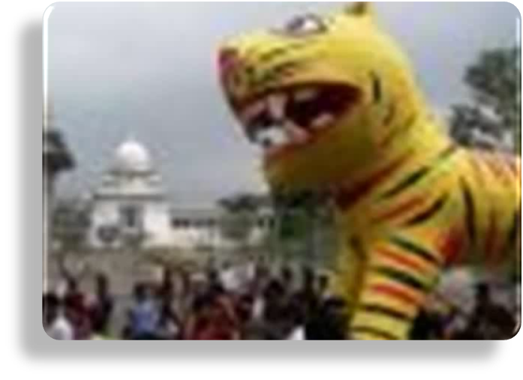
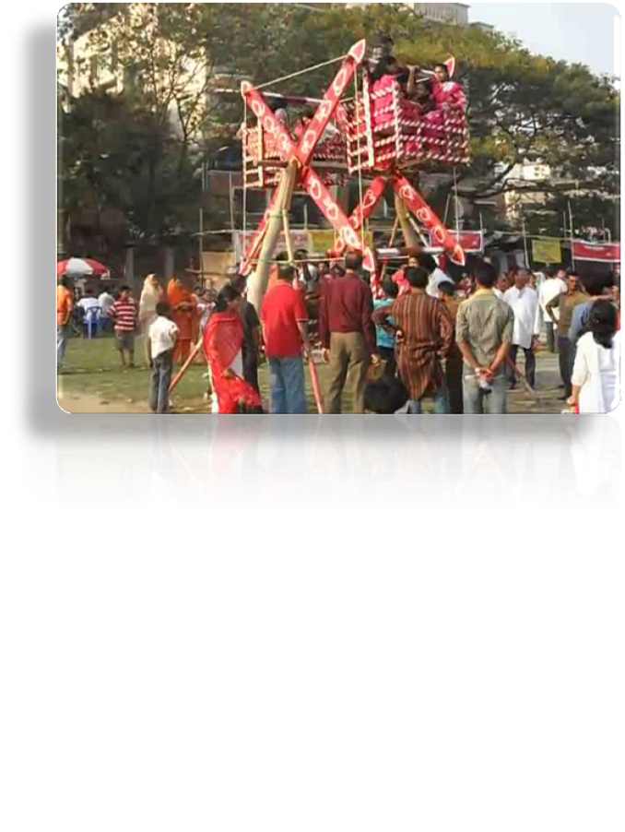
Team work
Watch the images then discuss in groups what preparations you will need in order to hold a Boishakhi mela at your school. Make a list of the activities you want to have during the mela.

Slide 9
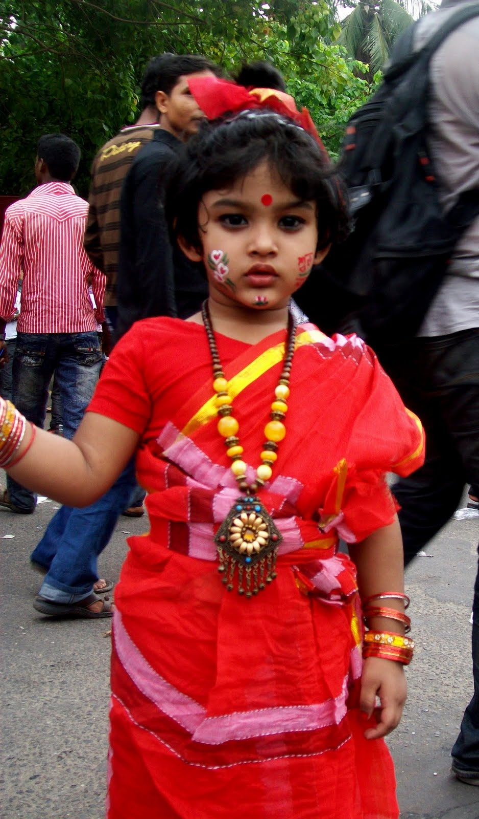
EVALUATION
What are the traditional dresses for man & woman on the occation of Pahela Boishakh ?
When the program starts?
Why people eat Panta-ilish on Pahela Boishakh?
How should we celebrate Pahela Boishakh?

Slide 10

Home work
Write in brief, how you have celebrated Pahela Boishakhi this year.

Slide 11

Thank you

